Slide 1
FUEL EFFICIENCY PREDICTION AND ANALYSIS FOR AUTOMOTIVE INSIGHTS

Slide 2
AGENDA
Problem Statement
Introduction
Dataset Overview
Exploratory Data Analysis
Data Preprocessing & Feature Engineering
Models Selection and Training
Model Comparison Summary
Feature Importance
Insights (Business Insights and Future Scope)
Conclusion

Slide 3
PROBLEM STATEMENT
As Fuel Prices And Environmental Concerns Continue To Rise, Optimizing Vehicle Fuel Efficiency Has Become A Crucial Challenge For Automobile Manufacturers.
However, Understanding How Different Design And Performance Factors Impact Fuel Efficiency Is Complex.
This Project Aims To Solve This Problem By Analyzing Automotive Data To Accurately Predict Fuel Efficiency Based On Vehicle Specifications.

Slide 4
INTRODUCTION
In Today’s Automotive Market, Fuel Efficiency Plays A Vital Role In Determining A Vehicle’s Performance, Market Value, And Environmental Impact.
Rising Fuel Costs And Increasing Awareness Of Carbon Emissions Have Pushed Manufacturers To Focus On Optimizing Fuel Consumption.
However, Fuel Efficiency Depends On Multiple Interacting Factors Such As Engine Power, Vehicle Weight, Acceleration, And Manufacturing Year, Making It Difficult To Estimate Accurately.
This Project Aims To Analyze Historical Automobile Data To Understand The Key Determinants Of Fuel Efficiency And Build A Predictive System That Can Accurately Estimate A Vehicle’s Mpg.
The Insights Gained Can Support Better Vehicle Design, Cost Optimization, And Sustainability Initiatives.

Slide 5
DATASET OVERVIEW
Column Name | Description
Mpg | Fuel efficiency (miles per gallon) — Target variable
Cylinders | Number of engine cylinders
Displacement | Engine size or capacity (in cubic inches)
Horsepower | Engine power output
Weight | Vehicle weight (in pounds)
Acceleration | Time to accelerate from 0–60 mph (in seconds)
Model year | Year of the car model
Origin | Region of origin → 1 = USA, 2 = Europe, 3 = Japan
Car name | Name of the car (dropped for modelling)

Slide 6
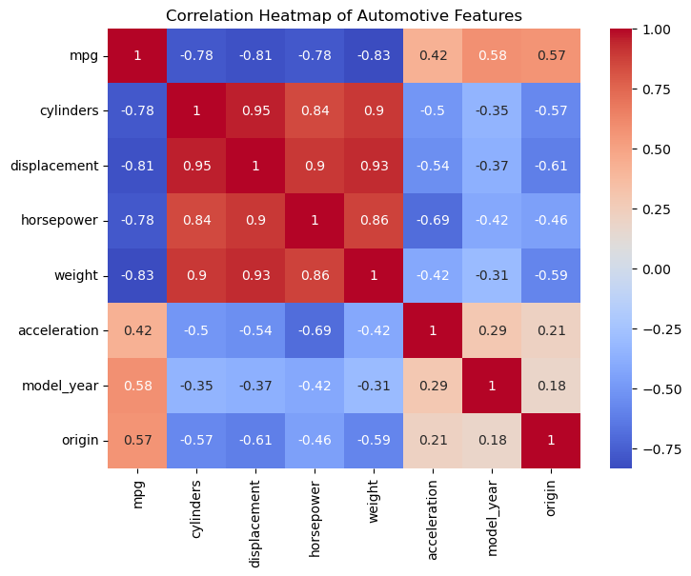
EXPLORATORY DATA ANALYSIS
Feature | Correlation With MPG | Insight
Weight | –0.83 | Heavier Cars Have Lower Fuel Efficiency.
Displacement | –0.81 | Larger Engines Consume More Fuel, Reducing MPG.
Cylinders | –0.78 | Cars With More Cylinders Are Generally Less Fuel-efficient.
Horsepower | –0.78 | High Engine Power Leads To Higher Fuel Use.

Slide 7
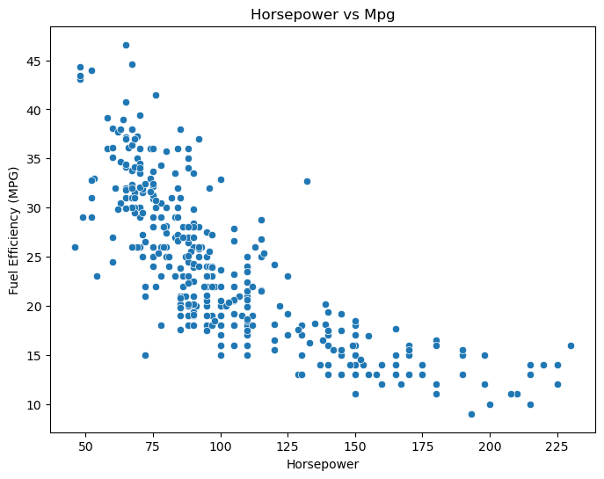
High-horsepower Vehicles (Powerful Engines) Tend To Consume More Fuel, Resulting In Lower MPG.
Low-horsepower Vehicles, Often Smaller Or Lighter, Achieve Higher Fuel Efficiency.
The Relationship Is Non-linear — The Drop In Mpg Is Sharper For The Lower Range Of Horsepower And Then Gradually Flattens For High Values.

Slide 8
DATA PREPROCESSING AND FEATURE ENGINEERING
Loaded Dataset And Inspected Data Types, Null Values, And Structure.
Converted Horsepower Column To Numeric Format.
Dropped Car name (Non-numeric And Irrelevant For Prediction).
Selected Key Numerical Features: Cylinders, Displacement, Horsepower, Weight, Acceleration, Model year, Origin.
Analyzed Feature Correlations With Mpg Using A Heatmap.
Split Data Into Training (80%) And Testing (20%) Sets For Modeling.

Slide 9
MODEL SELECTION AND TRAINING
Split Data Into Training (80%) And Testing (20%) Sets.
Built Two Regression Models: Linear Regression And Random Forest Regressor.
Trained Models Using Training Data And Tested On Unseen Data.
Evaluated Performance Using:
MAE (Mean Absolute Error)
RMSE (Root Mean Squared Error)
R² Score (Accuracy Measure)

Slide 10
MODEL COMPARISON SUMMARY
Model | Mean Absolute Error (MAE) | Root Mean Squared Error (RMSE) | R² Score | Remarks
Linear Regression | 2.42 | 3.27 | 0.79 | Good baseline model; assumes linear relationships.
Random Forest Regressor | 1.76 | 2.47 | 0.88 | Higher accuracy, captures complex, non-linear patterns.

Slide 11
FEATURE IMPORTANCE (IMPACT ON FUEL EFFICIENCY)
There Is A Clear Downward Trend In The Plot.
As Horsepower Increases, The Fuel Efficiency (MPG) Decreases.
This Shows A Negative Correlation Between The Two Variables.
Lightweight And Smaller Engines Achieve Better Mileage.

Slide 12
INSIGHTS
BUSINESS INSIGHTS:
Fuel Efficiency Drops With Higher Horsepower, Engine Size, And Weight — Lighter And Smaller Engines Are More Economical.
Newer Car Models Show Better Mpg, Reflecting Technological Improvements.
Japanese And European Cars Demonstrate Higher Efficiency — Global Design Practices Can Be Adopted.
The Random Forest Model (R² = 0.88) Can Help Predict And Optimize Fuel Efficiency Before Production.
Insights Support Cost Reduction, Eco-friendly Design, And Smarter Manufacturing Decisions.
FUTURE SCOPE:
Include Additional Features Like Engine Type, Fuel Type, Transmission, And Aerodynamics For Better Accuracy.
Apply Advanced Models Such As Xgboost Or Deep Learning For Improved Prediction Performance.
Develop A Real-time Prediction Dashboard For Manufacturers To Simulate And Test New Vehicle Designs.
Extend The Model For Electric And Hybrid Vehicles To Support Future Mobility Trends.

Slide 13
CONCLUSION
The Project Successfully Analyzed Automobile Data To Predict Vehicle Fuel Efficiency (Mpg) Using Key Attributes Such As Horsepower, Weight, Displacement, And Model Year.
Exploratory Analysis Revealed That Horsepower, Weight, And Engine Displacement Have A Strong Negative Impaction Mpg — Meaning Heavier And More Powerful Vehicles Consume More Fuel.
Model Year And Origin Showed A Positive Correlation With Fuel Efficiency, Indicating That Newer Models And Certain Regions Produce More Efficient Vehicles.
Two Models Were Built — Linear Regression And Random Forest Regressor — And Random Forest Performed Better With An R² Score Of 0.88, Compared To 0.79 For Linear Regression.
The Results Confirm That Fuel Efficiency Depends On Complex, Non-linear Relationships Among Features, Which Ensemble Methods Like Random Forest Capture More Effectively.
Overall, The Study Provides Valuable Insights For Automobile Manufacturers To Design Lighter, More Efficient, And Performance-balanced Vehicles, Helping Reduce Fuel Consumption And Environmental Impact.

Slide 14
Thank You!
Presented By : Dhayananth J

